Slide 1

DFS Installation and configuration in windows server 2016
Presentation Subtitle
Notes:
<number>

Slide 2

Outline
What is DFS?
How does DFS Work?
Advantage of DFS
Disadvantage of DFS
Application of DFS
Notes:
<number>

Slide 3

What is DFS
(DFS) is the abbreviation of the distributed file system.
Which is a file system that store data on a server
Through DFS, you can easily share information and files between users on the network in a controlled and authorized manner.
Notes:
<number>

Slide 4


How does DFS work
Standalone DFS namespace
Domain-based DFS namespace
Notes:
<number>

Slide 5
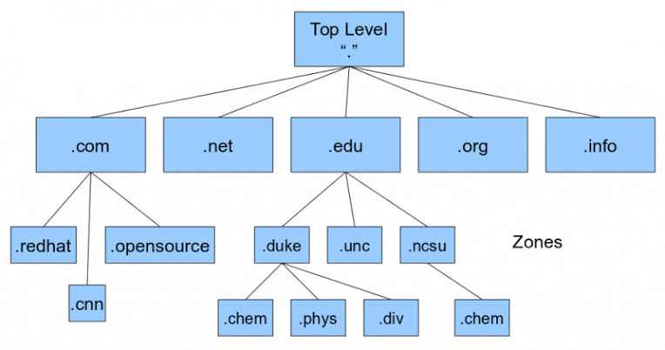
Domain-based DFS namespace
Use Active directory
Support multiple root
Standalone DFS namespace:
Don’t use Active directory
Support single root
Notes:
<number>

